Slide 1
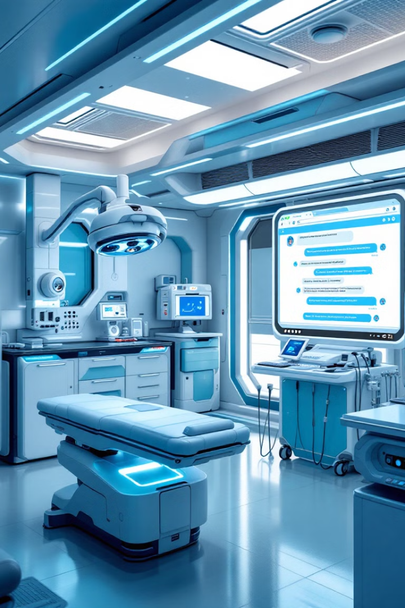
Healthcare Chatbots: (Using AI & NLP)

Slide 2



GROUP MEMBERS

Slide 3
What are Healthcare Chatbots?
AI-powered assistants
Natural Language Processing
Bridge between technology and care
Healthcare chatbots are virtual assistants that leverage AI to provide healthcare services.
They use NLP to understand and respond to patients' queries in a natural way.
They connect patients with healthcare information and services through technology.

Slide 4
How do Healthcare Chatbots Work?
Understanding patient queries
System integration
Continuous learning
NLP enables chatbots to interpret patient questions and requests, even those using medical jargon.
They connect with existing healthcare systems like EHRs and scheduling tools.
Chatbots use machine learning to improve accuracy and adapt to new information and situations.

Slide 5
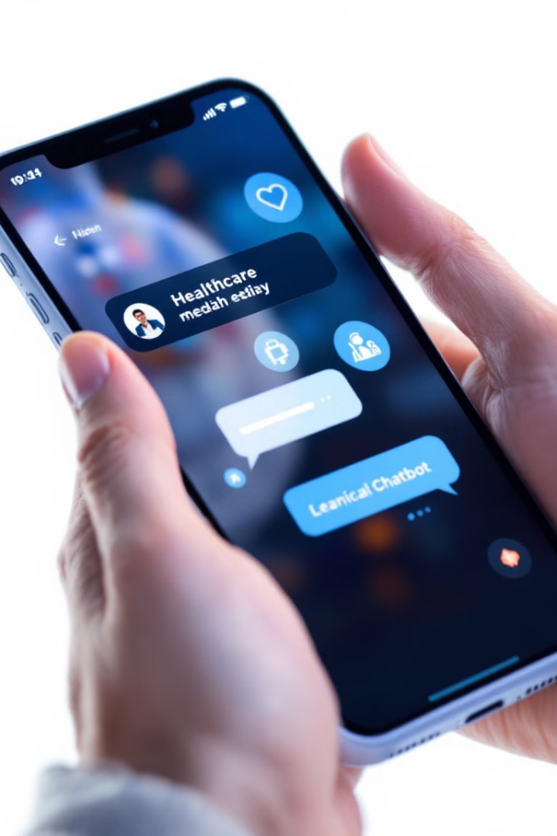
Key Features of Healthcare Chatbots
1
24/7 availability
Patients can access information and support at any time.
2
Multi-language support
Chatbots can communicate in multiple languages, both text and voice.
3
Symptom analysis
They can assist with symptom analysis and basic medical diagnosis.
4
Medication management
Chatbots can provide medication reminders and support with adherence.

Slide 6

Benefits of Healthcare Chatbots
Reduced costs
Improved patient engagement
Streamlined processes
Chatbots automate tasks, leading to cost savings in healthcare delivery.
Chatbots enhance patient engagement and accessibility to healthcare information.
They streamline administrative processes and improve efficiency in healthcare.

Slide 7
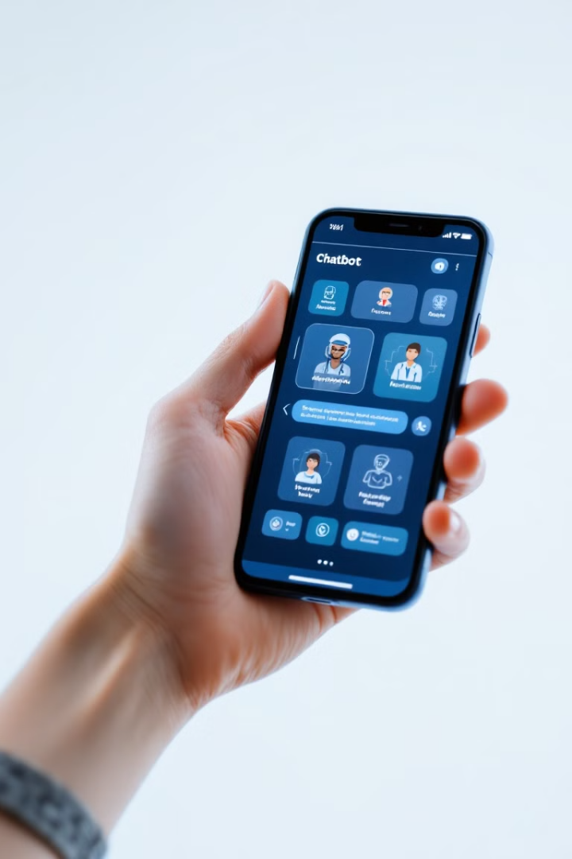



Real-World Applications
Symptom checkers
Medication reminders
Appointment scheduling
Chatbots can help patients assess their symptoms and receive initial guidance.
Chatbots can remind patients to take their medications as prescribed.
Chatbots can help patients schedule appointments with healthcare providers.

Slide 8
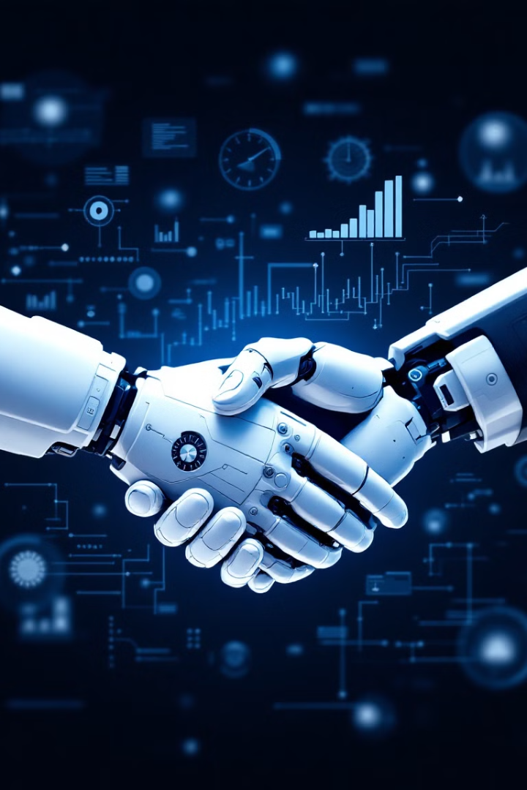
Challenges and Considerations
1
Data privacy and security
Healthcare data is sensitive, and chatbots need to comply with regulations like HIPAA.
2
Accuracy of information
Chatbots need to provide accurate medical information and avoid misdiagnosis.
3
Integration with healthcare systems
Seamless integration with existing systems is crucial for smooth operation.

Slide 9
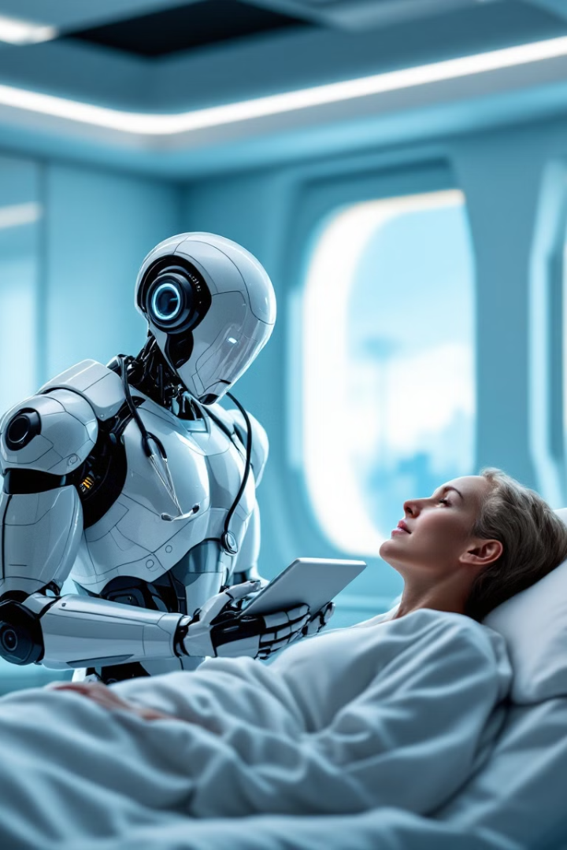



Future of Healthcare Chatbots
Integration with wearables
Chatbots will be integrated with wearable devices for real-time health monitoring.
Personalized treatment recommendations
Chatbots will use AI to provide personalized treatment recommendations.
Emotional intelligence
Chatbots will be able to understand and respond to patients' emotions.

Slide 10

Case Studies
1
NorthShore-Edward-Elmhurst Health
ED chatbot for social determinants of health, reducing wait times and improving patient satisfaction.
2
Mount Sinai
Web-based symptom checker, providing patients with accurate information and guidance.

Slide 11

Conclusion: Transforming Healthcare Delivery
Healthcare chatbots are poised to revolutionize patient care, making healthcare more accessible, efficient, and personalized. They are an essential tool for the future of healthcare.

